Slide 1
Phase I System Presentation
THEIA
By: Nicole Fuller, Emily Porter, Noah Schmalenberger, Joshua Allard, Lance Tieng, Alena Watts
Notes:
Maybe one of the as is could be transition to different floor of the same building. Or maybe discussing further customization within the app

Slide 2
Scenario 1: Navigation
As-Is
Stevie is trying to go to his next classroom. He knows he needs to walk ahead a few steps, and then turn left around the corner.
However, he is not sure when to turn.
He took a guess, but turned too early, hit the wall and hurt his head.
To-Be
The THEIA app asks Stevie to give his current location and the destination.
The app calculates the route from the current location to the destination.
THEIA tells Stevie to “Walk ahead 10 steps, then turn left”

Slide 3
Scenario 2: Temporary Obstacle Avoidance
As-Is
Stevie is walking down a hallway toward his next classroom.
Someone left a chair in the hallway that they were using to hang up a banner.
Stevie ran into the chair and fell over.
To-Be
As Stevie walks down the hallway, THEIA uses the phone’s sensors to detect obstacles ahead.
THEIA tells Stevie “In 10 steps, step slightly to the right”
THEIA resumes navigation instructions once past the obstacle.

Slide 4
Scenario 3: Configuration
As-Is
Stevie is completely blind. He needs increased assistance to move around.
Stevie uses another version of an aid app, which applies to a broader audience of visually impaired people.
The app is not tailored to his disability, and due to lack of vocal instruction, he is unsure of his location or how to get to his next classroom.
To-Be
THEIA can be configured by a caretaker to fit Stevie’s needs.
THEIA includes multiple settings for caretakers to customize, including increased vocal instruction.
Stevie can navigate successfully to his next classroom with additional aid.
Notes:
Emily

Slide 5
Scenario 4: Emergency Assistance
As-Is
Stevie is walking down a hallway toward his next classroom.
Stevie accidentally trips, falls, and loses his phone.
Stevie can’t find his phone and has to wait until someone stumbles upon him to help him.
To-Be
THEIA uses the phone’s sensors to detect any fall.
When Stevie falls, THEIA tells Stevie “It seems like you’ve fallen. Are you okay?”
If there is no response within 15 seconds, THEIA automatically sends an alert about the fall along with his location to the designated caretaker.

Slide 6
Scenario 4 Further Analysis
What could go wrong when waiting for a user response?
No user response (No Response, and Slow Responder) → Automatically contact the caretaker and send location
The user says they are okay → Ask if they need assistance finding the phone, in that case play a noise so they can locate it
The user responds they need help → Contact the caretaker and send location
The user’s response is undetermined (Inconsistent response) → Repeat the question, if this happens twice, count it as no response
What could go wrong with contacting the caretaker?
There is no caretaker → Contact emergency services
Caretaker phone number is incorrectly set up → Contact emergency services
Caretaker is appropriately defined → Contact caretaker
Notes:
Question types
• “What-if”
– hypothetical “what could go
wrong” lines of reasoning
• i.e. "What could go wrong with
participants’ response to the date
set?“
– (i) Participants submit consistent preferred
date set
– (ii) Participants submit inconsistent
preferred & exclusion (Inconsistent sets)
– (iii) Participants submit preferred date set
late (Slow Responder)
– (iv) Participants do not submit preferences
(No Response)

Slide 7
Scenario 4 Further Analysis
Who initiates the emergency assistance?
The application automatically detects when to activate emergency assistance by using the device sensors
A keyword can be triggered to initiate emergency assistance
What kinds of contacts are supported?
A single caretaker can be defined with a phone number
Multiple caretakers can be defined individually, with each being contacted
Option to automatically call emergency services
Notes:
• “Who”
– “Who initiates a meeting?”
• (i) An initiator (person)
• (ii) An initiator (person) & the meeting
scheduler
• (iii) the meeting scheduler
• “What-kinds-of”
– “type of meeting supported?”
• (i) one-time meeting
• (ii) recurring meeting

Slide 8
Scenario 4 Further Analysis
If the user doesn’t respond to the emergency assistance prompt, how long does the application wait before contacting the caretaker/emergency services?
The application waits 15 seconds after determining a “no response” before preceding
When emergency assistance is completed, what happens to the application afterwards?
The application returns to normal state
How does a user stop emergency assistance after it has started?
The user must prompt the system to stop with a verbal command
The system errors on continuing emergency assistance instead of cancelling to error on the side of user safety
Notes:
• “When”
– “If some attendees do not
respond, waiting how long
before schedule the meeting
anyway”
• deadline
• “How-to”
– “resolve conflicts?”
• (i) via scheduler
• (ii) via initiator (person) and the
scheduler

Slide 9
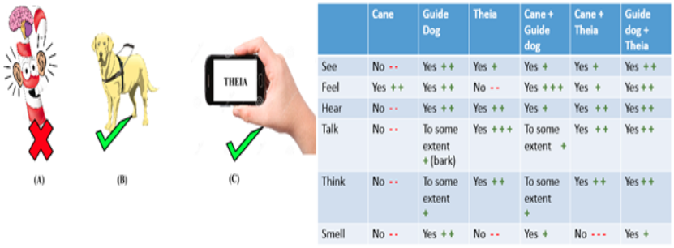
Comparisons for Cane, Dog, and THEIA (tools only)
Notes:
Compare advantages and disadvantages of theia compared to a cane and a dog
Justify why theia would be the best navigation tools for a blind person

Slide 10
Comparisons for Cane, Dog, Stevie, and THEIA (user + tools)
 | Cane | Dog | Stevie | Theia | Stevie + Cane | Stevie + Dog | Stevie+ Cane + Theia | Stevie + Dog + Theia
See | No | Yes | No | Yes | No | Yes | Yes | Yes
Feel | Yes | Yes | Yes | No | Yes | Yes | Yes | Yes
Hear | No | Yes | Yes | Yes | Yes | Yes | Yes | Yes
Talk | No | To some extent (Bark) | Yes | Yes | Yes | Yes | Yes | Yes
Think | No | Yes | Yes | Yes | Yes | Yes | Yes | Yes
Smell | No | Yes | Yes | No | Yes | Yes | Yes | Yes

Slide 11
Additional Comparisons
Advantages:
Theia runs on a phone which is more compact and easier to carry than the other methods of assistance such as a guide dog or cane.
Anyone can download Theia anywhere while other means may take additional time to acquire.
Can be more detailed as the application can communicate directly with the user.
Disadvantages:
Reliance on an internet connection to route the person to where they need to walk while other methods do not.
Theia relies on a camera to detect obstacles while guide dogs and canes physically detect obstacles. Some may argue the reliability of service dog versus a camera.
The device that Theia is running on can lose power resulting in the immediate end of services, while other methods don't have this issue.

Slide 12
Justification
We believe that Theia will provide a better service for those with impaired vision because of the convenience and accessibility of being able to be accessed from any smartphone device. Being able to communicate with the user directly provides a more clear instruction between the user and assistance device. Despite some of the drawbacks of the application, there is still some true potential Theia has in assisting those with impaired vision.

Slide 13
THANK YOU

